Slide 1
Capstone Demo 3 Presentation
DaVinci Code Smart Parking System

Slide 2
TABLE OF CONTENTS
01
02
03
05
04
Live Demo
Architectural Patterns
Machine Learning Model
CI/CD Testing
Documentation and Repository

Slide 3
01
Live Demo

Slide 4
Live Demo
We will demonstrate how the system improved from Demo 1

Slide 5
02
Architectural Diagram

Slide 6
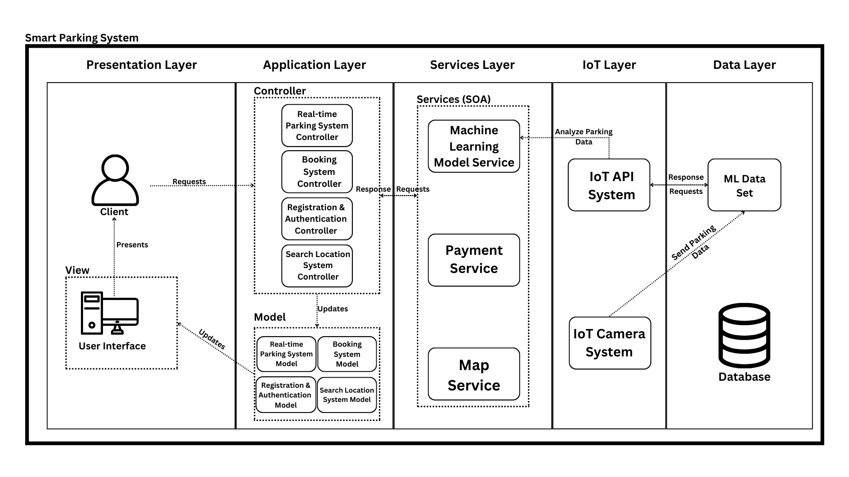
Architectural Diagram

Slide 7
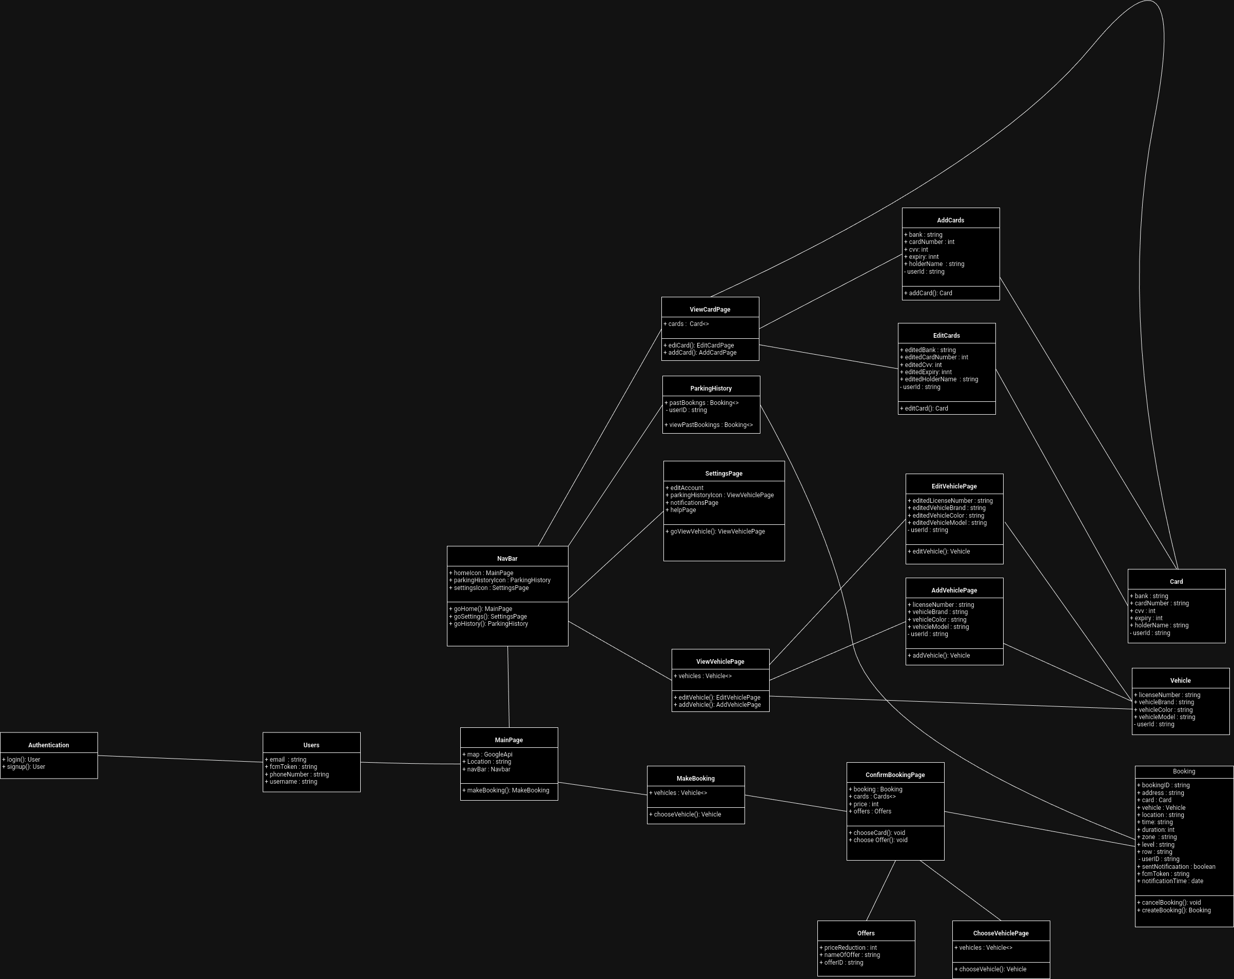
Class Diagram

Slide 8
03
Machine Learning Model

Slide 9
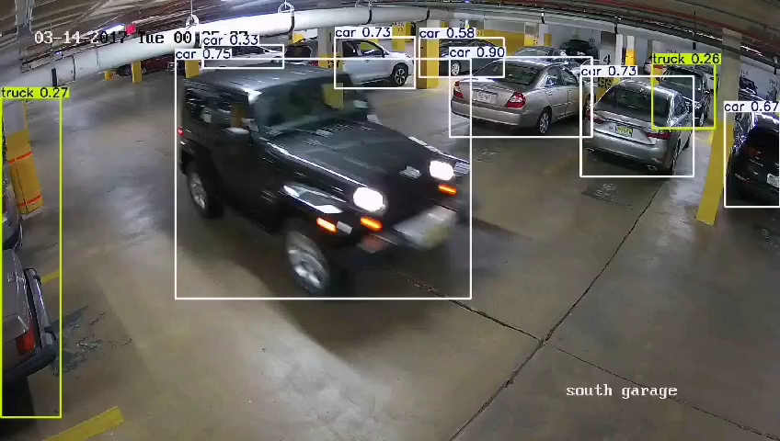
Overview
We have developed a pre-trained model

Slide 10
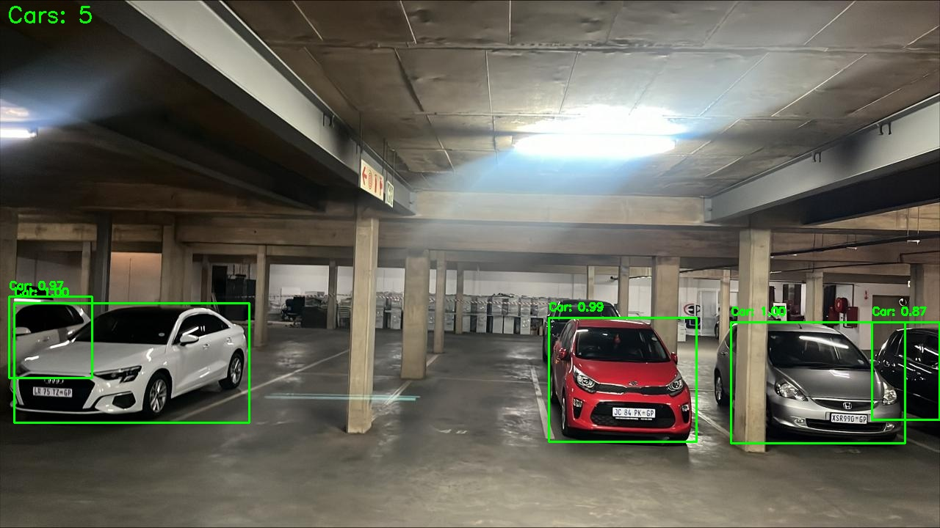
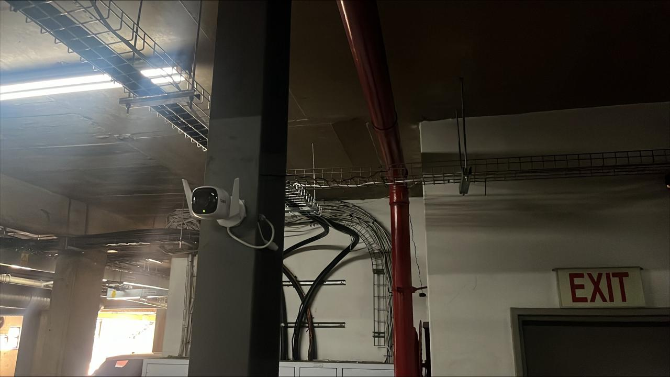
Camera Deployment
We have deployed our camera at EPI-USE basement Parking

Slide 11
04
CI/CD Test

Slide 12
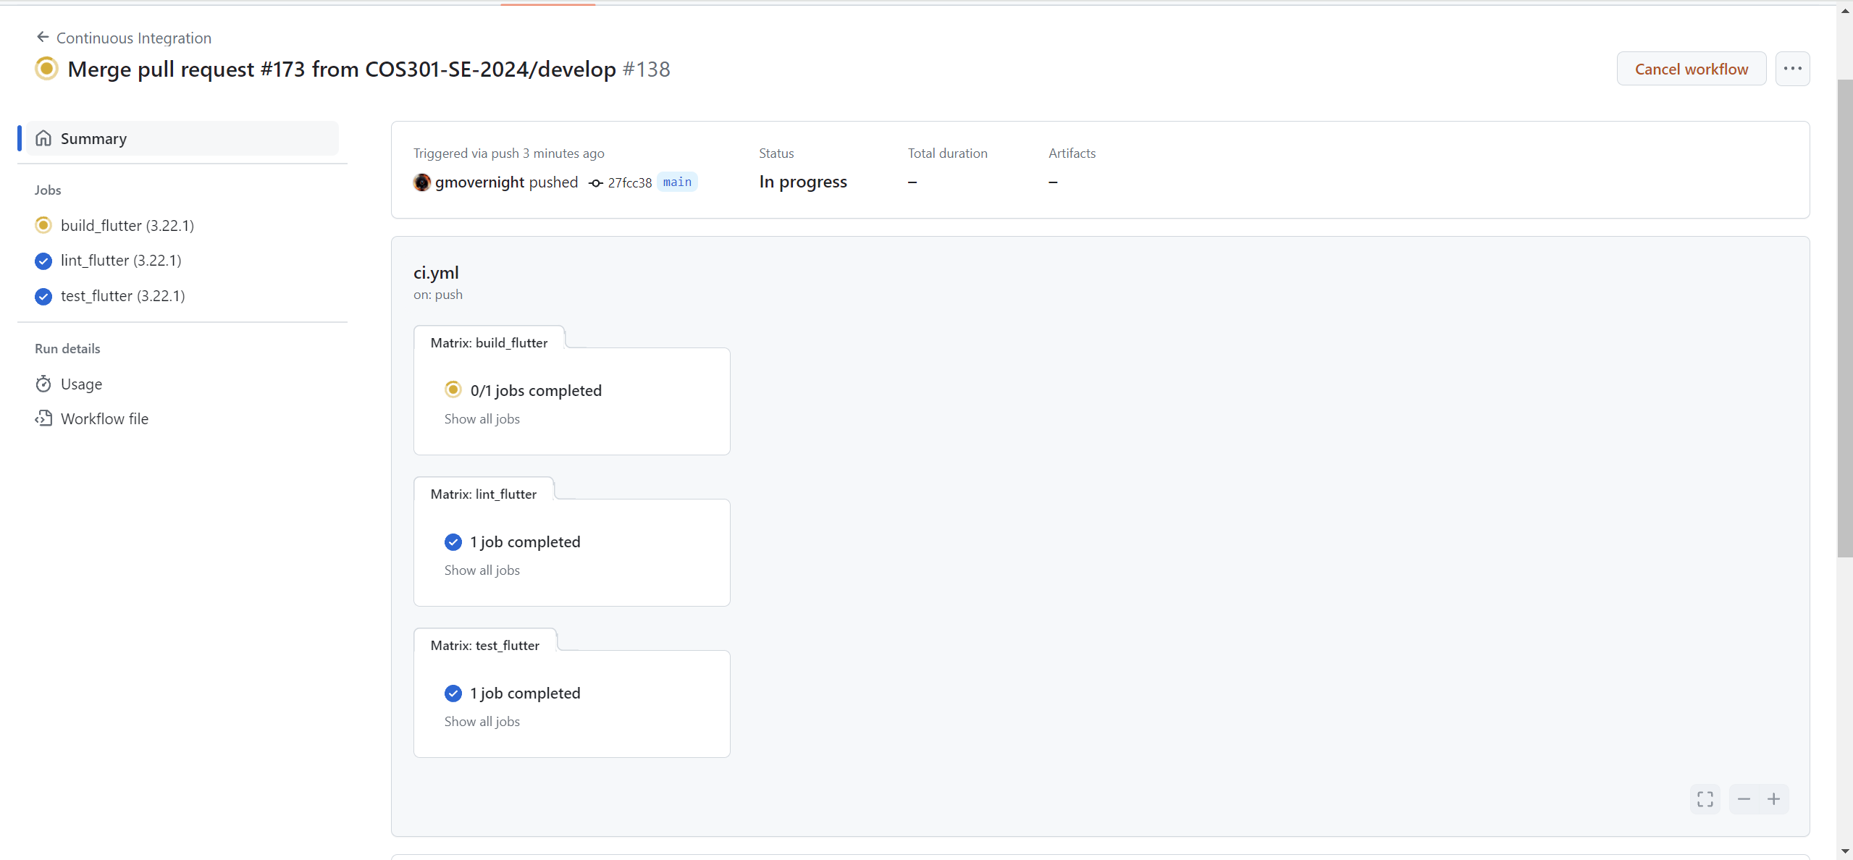
CI/CD Test

Slide 13
05
Documentation and Repository

Slide 14

Github
Repository Link: https://github.com/COS301-SE-2024/Smart-Parking-System
Project Board Link: https://github.com/orgs/COS301-SE-2024/projects/93

Slide 15
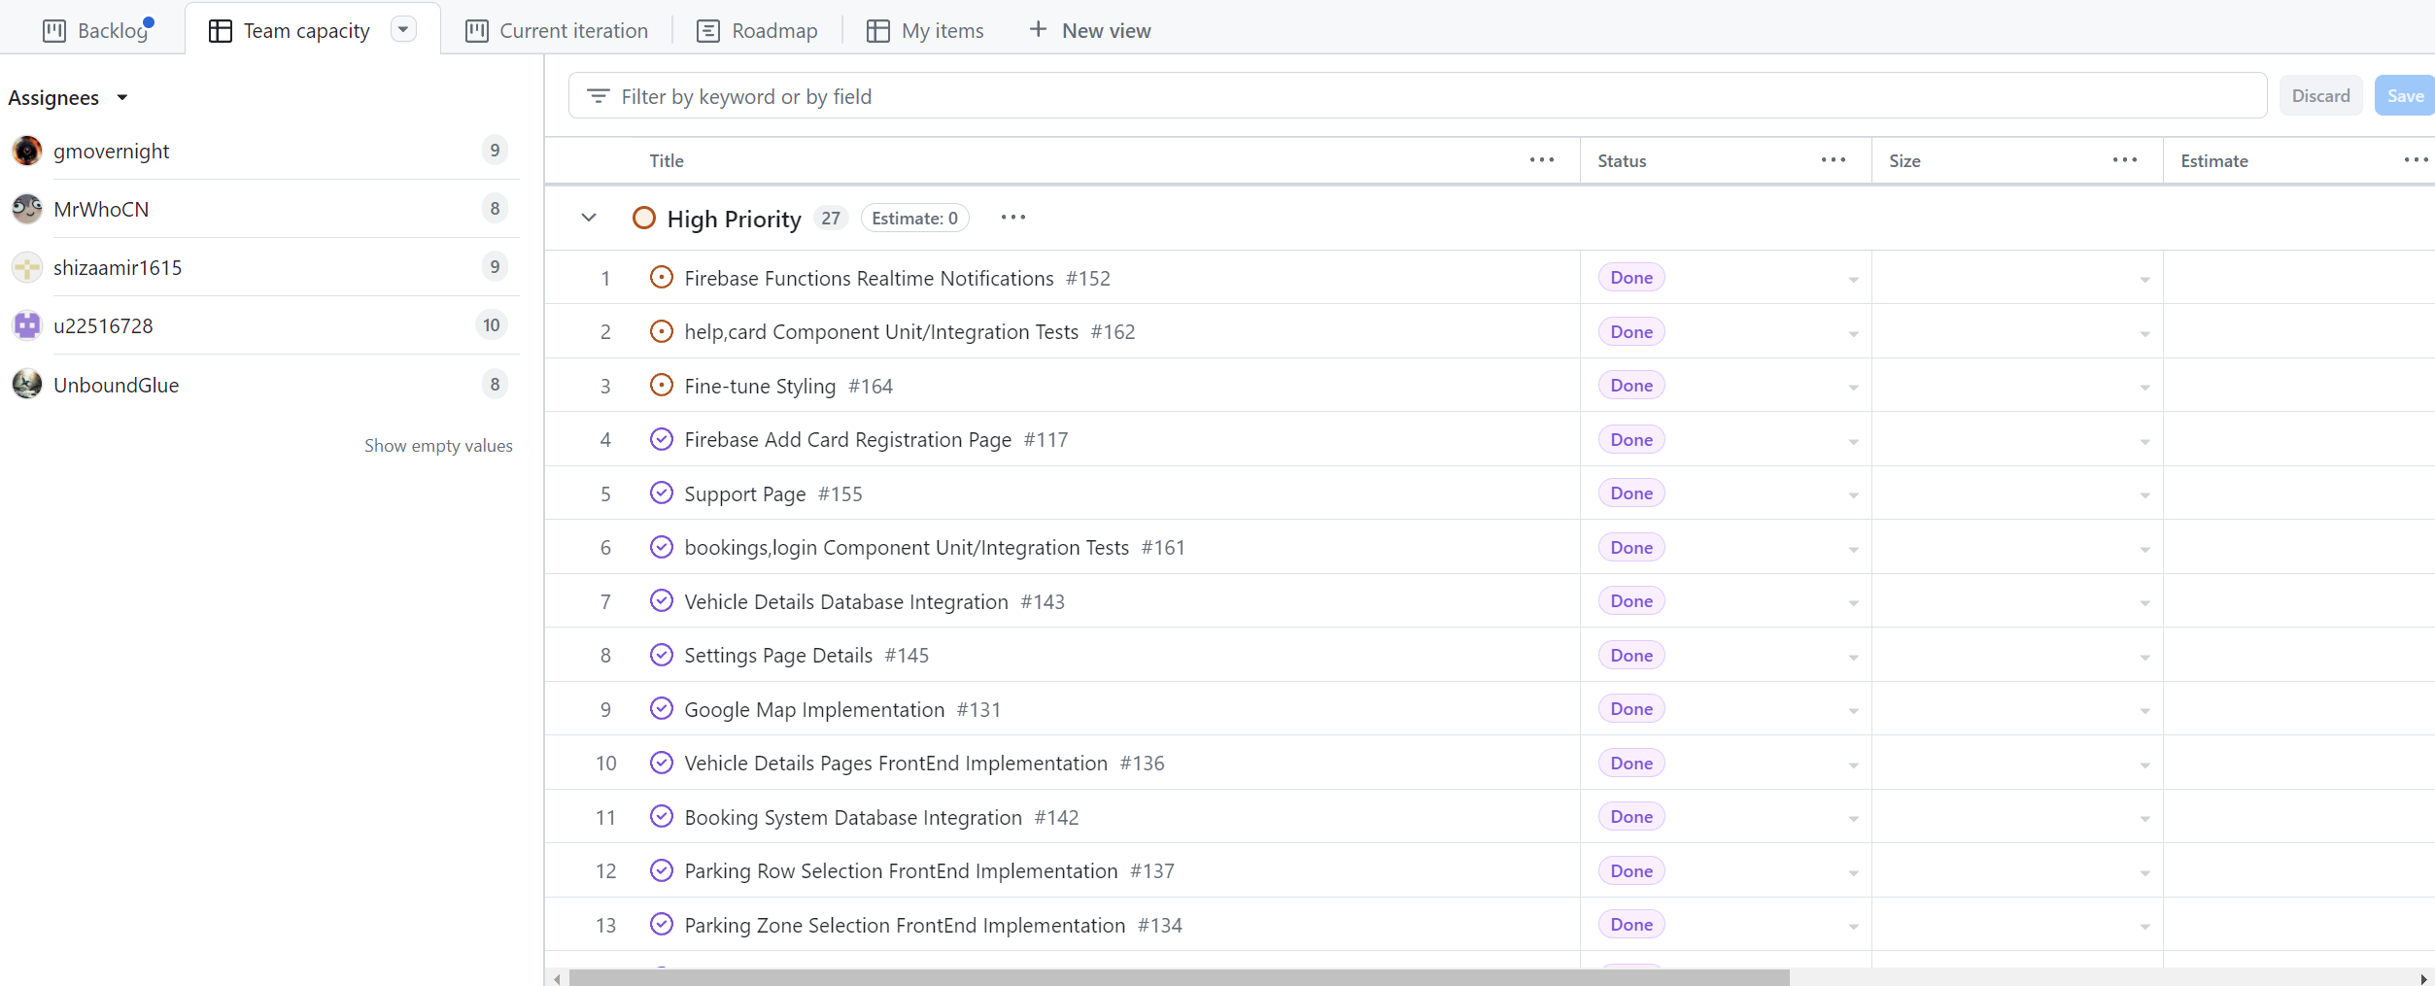
Github Project Board

Slide 16
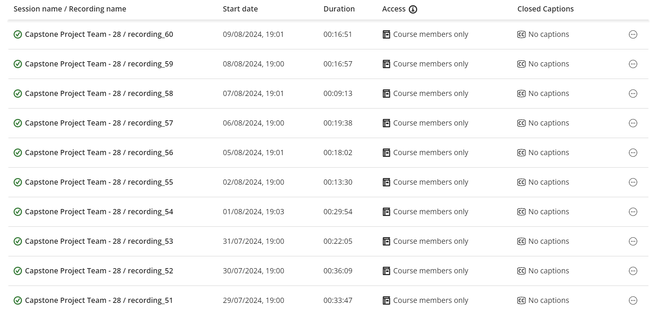
Daily meeting

Slide 17
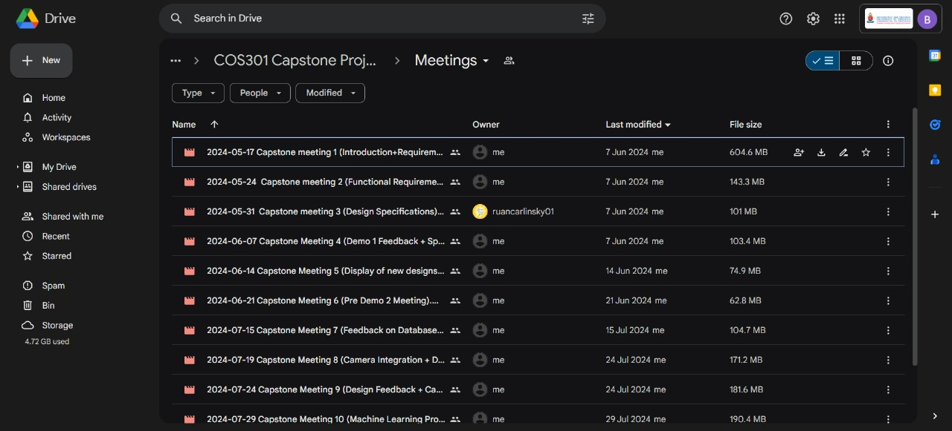
Meeting with our client

Slide 18
Q & A
Email to : davincicode.capstone@gmail.com

